Slide 1
HOME REMEDIES
Always Caring Always Here

Slide 2
JAYANT RAWAT: 11808824 HRITHIK KUMAR:11811656
Submitted To:
Dr. Ajay Shriram Kushwaha
Assistant Professor,
School of Computer Applications,
Lovely Professional University, Punjab

Slide 3
About Us
Home Remedy is a treatment to cure a disease or ailment that employs certain spices, vegetables, or other common items. Home remedies may or may not have medicinal properties that treat or cure the disease or ailment in question, as they are typically passed along by laypersons.

Slide 4
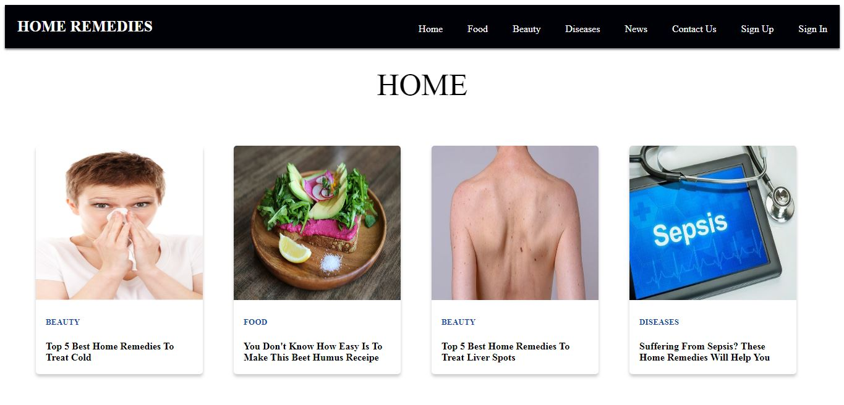
HomePage

Slide 5
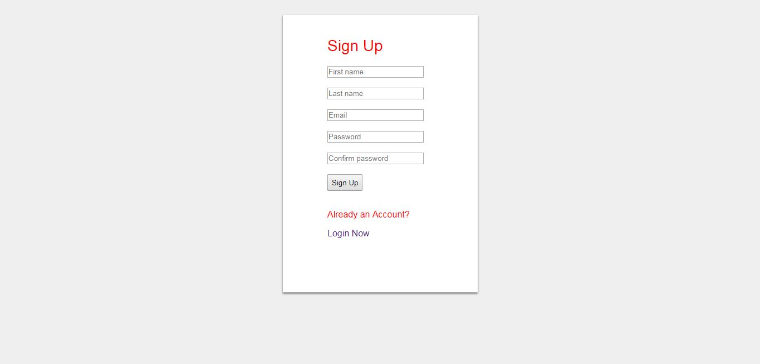
SignUp Form

Slide 6
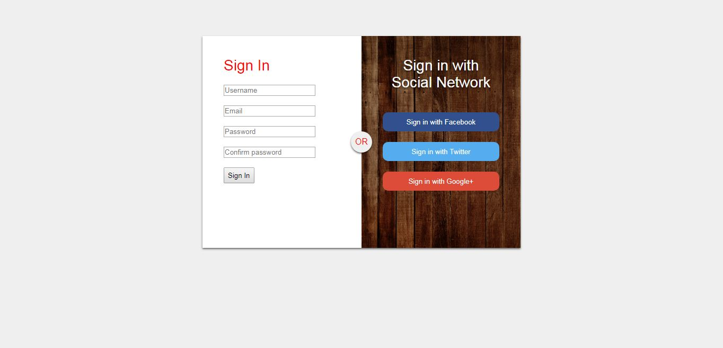
SignIn Form

Slide 7
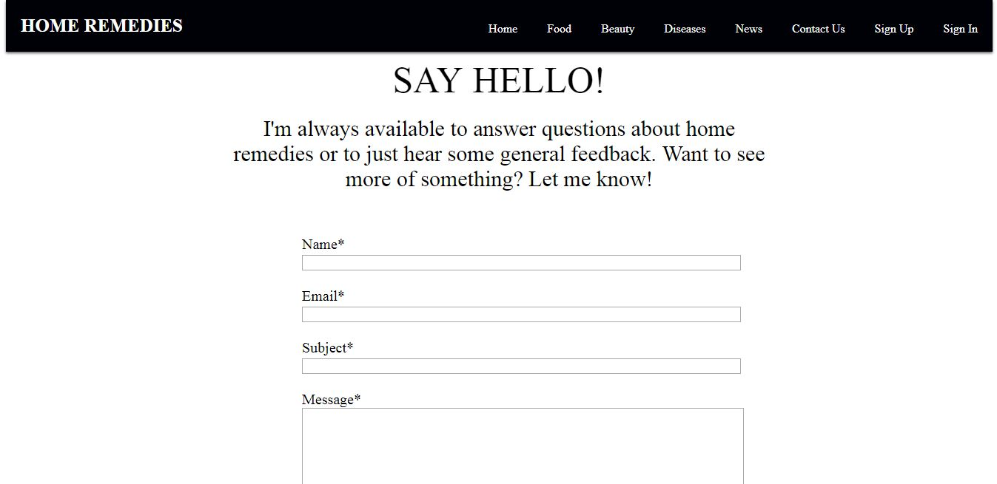
Contact Us

